Slide 1
Investments in Irrigation Infrastructure Estimation of Water Losses and Efficiency of an Irrigation System. Determining of the Potential Water Savings Due to Investments in Irrigation Infrastructure
Jovana Andrijevic

Slide 2
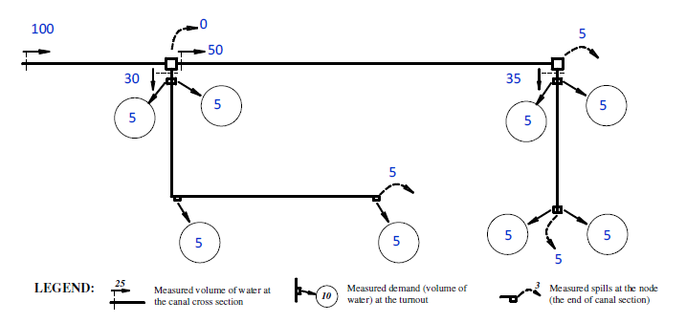
Initial data
A simplified scheme of the investigated Irrigation System (IS)
The IS consists of 8 Irrigation Fields (IFs).
The delivery network of IS has a Main Canal with two sections and two Distributary Canals.
Fig. 1. Schematic View of the Delivery Network of the IS and Measured Volumes of Water at Specific Locations

Slide 3
Estimation of Water Losses and Efficiency of the IS
The water losses in the IS delivery network can be classified as technical and operational.
The technical lossesΔV are due to the technical status of the canals and structures in the delivery network. They are estimated as:
V_{dir} is the directed volume of water at the inlet of the canal section, m³;
V_{del}–the delivered volume of water at the outlet of the canal section, m³;
ΣU is the sum of volumes supplied to clients in the canal section (volumes measured at turnouts of the IFs).
The operational losses ΔOp depend on the distribution method used in the delivery network of the IS.
Represented by the volumes of water, which are spilled unused during the process of water delivery to clients. The operational losses in this case are estimated as:
V_{av} is the available for further delivery volume of water, m³.

Slide 4
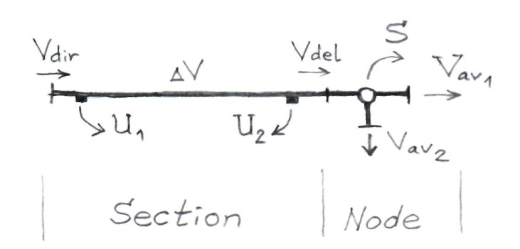
Estimation of Water Losses and Efficiency of the IS
Considering the equasions as a result of measurements in the current IS, the available volumes of water are equal to the sum of volumes directed at the inlets of the downstream canals.
The delivered volumes of water are not measured, but they can be estimated on the basis of the water balance of the canal section (Fig. 2), taking into account the eq. (2) and (3):
The technical losses ΔV can be estimated as: ΔV = V_{dir} – ΣV_{av} + ΣU + S, m³,
Fig. 2.
Water Balance
of the Canal Section

Slide 5
Estimation of Water Losses and Efficiency of the IS
Considering the types of losses, the following types of efficiencies are defined:
a) Technical efficiency η_{T}:
b) Operational efficiency η_{op}:
c) Overall efficiency η₀:
According to these eq. , the following relation can be drawn: η₀ = η_{T}η_{op}
Also, for any of the efficiency of the IS (technical, operational or overall), the following formula is valid:
- the average efficiency of the Main Canal;
- the average efficiency of the Distributary Canals.

Slide 6
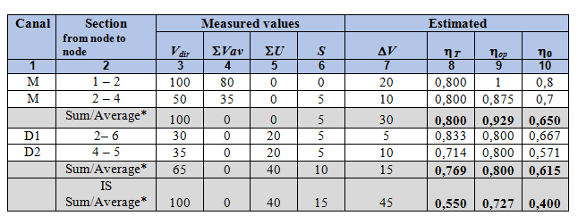
Estimation of Water Losses and Efficiency of the IS
Table 1. Estimation of Water Losses and Efficiencies of the Delivery Network (Volumes in million m³)
Processing data in Table 1
Column {1} – Canal sections (described, starting from the head of the Main Canal);
Column {2} – Sections, described with starting and ending node;
Column {3} – Volumes directed at the canal/section inlet, in million m³;
Column {4} – Sum of the volumes at the inlets of canals, which start from the ending node of the canal section;
Column {5} – The total volumes delivered to the clients in the canal section (sum of volumes, measured at theturnoutsof the canal section), in million m³;
Column {6}- The spilled volumes, measured at the ending node of the canal section, in million m³;
Column {7}- The technical losses volumes, estimated by eq. (5);
Column {8}- The technical efficiency, estimated by eq. (6);
Column {9}- The operational efficiency, estimated by eq. (7);
Column {10}- The overall efficiency, estimated by eq. (8);

Slide 7
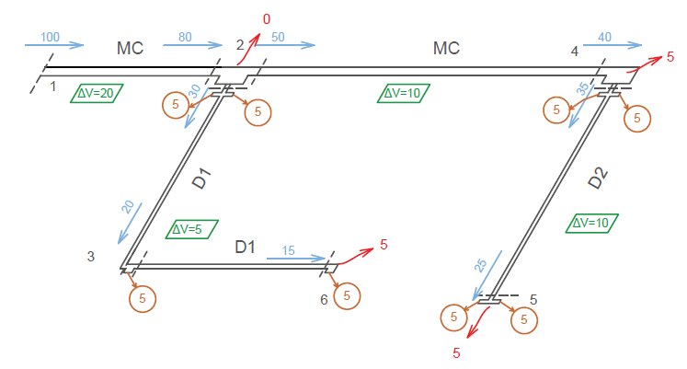
The losses can be estimated also by directly solving on the scheme of the balance equation of different nodes in the network
Fig. 3. Estimated Technical (ΔV) and Operational (S) Losses for the IS
(Volumes in million m³)

Slide 8
Estimation of Water Losses and Efficiency of the IS
2. Estimation of Potential Water Savings
According to the TOR, the investments for improvement (rehabilitation) of irrigation infrastructure will be done for the canal section which has the biggest technical losses of water and the lowest technical efficiency η_{T}.
The investments will be for rehabilitation of the worst subsection of the canal.
According to data in Table 1, for the current IS,
*The canal with the bigger technical losses is: Main canal (between nodes 1 and 2)
*The canal with the lowest technical efficiency: Distributory Canal 2 (between nodes 4 and 5).
There is no canal section which fulfills both of the requirements set in TOR.
It is decided that:
The section subject to rehabilitation is: Main Canal (between nodes 1 and 2),
because the losses of water in that section in absolute terms are the biggest ΔV = 20mil.m³.

Slide 9
Estimation of Water Losses and Efficiency of the IS
According to the TOR the Main Canal section has 3 subsections – I, II and III.
More detailed measurement has established that the total losses in the section ΔV are distributed in the 3 subsections as follows: Section I – 10%ΔV; Section II – 80%ΔV; Section III – 10%ΔV
According to the TOR the canal subsection II will be rehabilitated, because it has the biggest technical losses, thus, it is in the worst technical status.
Fig. 4. Losses in the Canal Subsections as percent of Total Losses in the Section

Slide 10
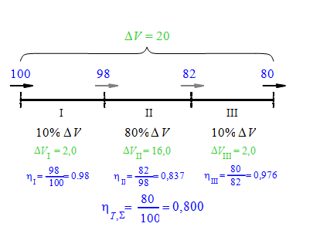
Estimation of Water Losses and Efficiency of the IS
The rehabilitation the losses in the worst canal subsection will be decreased to 25% of the losses before the rehabilitation.
For the canal subsection II, the new losses will be:
No other investments in IS infrastructure is made =>Assumptions:
for the next periods of time the demand (supplied volumes of water U) downstream of the rehabilitated canal =the same as before the investments
the technical losses and operational losses in the downstream canal sections remaining the same.
Fig. 5. Losses and
Technical Efficiencies
of the
Canal Subsections
before Rehabilitation

Slide 11
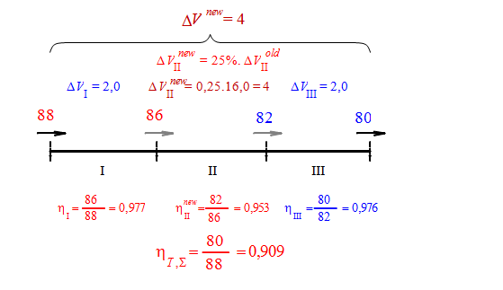
Estimation of Water Losses and Efficiency of the IS
Under these assumptions, at the outlet of canal section, the delivered volume has to be the same as before the investments
V_{del} = 80 mil.m³
Starting from the outlet of the last canal subsection, the new volumes of water at the inlet of the rest of the subsections are estimated, by summing the new technical losses in these subsections
Fig. 6. Losses and
Technical Efficiencies o
f the Canal Subsections
after Rehabilitation

Slide 12
Estimation of Water Losses and Efficiency of the IS
As a result of investments, the new directed volume at the inlet of the first canal subsection (the inlet of the Main Canal from node 1 to 2) has to be V_{dir} = 88 mil.m³
The Potential Water Savings (PWS) are estimated on the level of the investment.
“The level of investment” means that part of the IS, which benefits from the investment.
For the current case, the benefitting part of IS includes: (i) section of Main Canal from node 1 to node 2 and; (ii) the Distributory canal D2.
The PWS in absolute terms for this part of the IS are:

Slide 13
Estimation of Water Losses and Efficiency of the IS
According to the National Requirements, the investments are eligible if they assure RPWS between 5% and 25%. In the current case, RPWS = 12% > 5%, thus investments are eligible.
The formula for approximate estimation of RPWS by means of efficiencies is:
η _{new} overall efficiency of the distribution network of the IS after the rehabilitation (after the investments)
η_{old} overall efficiency of the distribution network of the IS before the rehabilitation (before the investments).
According to data in Table 1, the following values of overall efficiency of the benefiting part of IS are estimated:
The new overall efficiency of the MC for the section between nodes 1 and 2 is :

Slide 14
Estimation of Water Losses and Efficiency of the IS
The new overall efficiency of the benefiting part part of the IS will be:
The RPWS estimated by means of new and old efficiencies will be:
The error between the exact value (12%)
and the approximate value (13.57%) is +1.57%.

Slide 15
Thank you for your attention.

